Slide 1


SMART SHOE SOLE
TAMMY LE ALISON TEA ELLIE HENDRY MATT WILKINSON

Slide 2
Table of contents
01
04
02
05
03
Project Overview & Distinctions
Challenges Faced & Lessons Learned
Demo of Live View of Application
Biggest Takeaways
Demo of Activity Tracking Feature

Slide 3
01
Project Description.

Slide 4
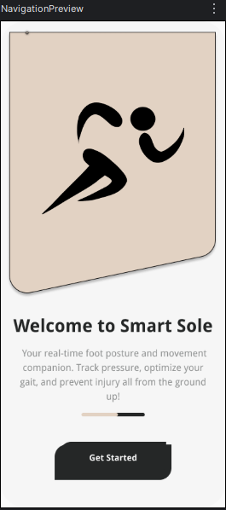
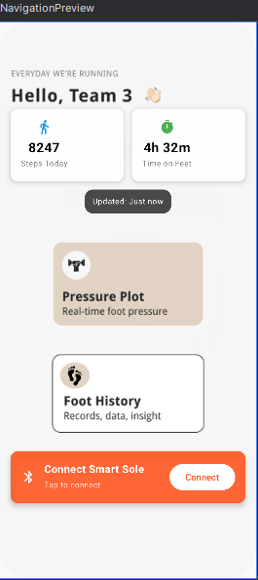
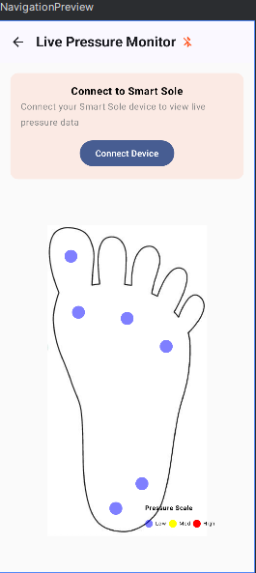
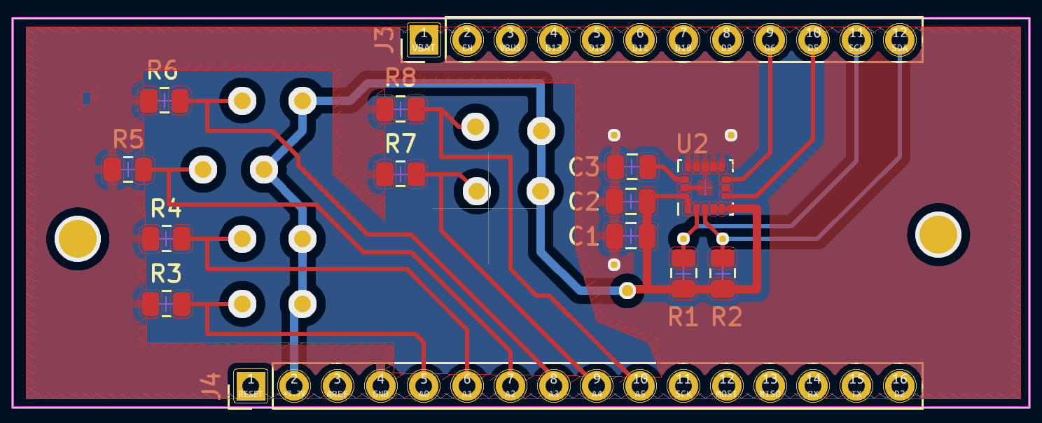
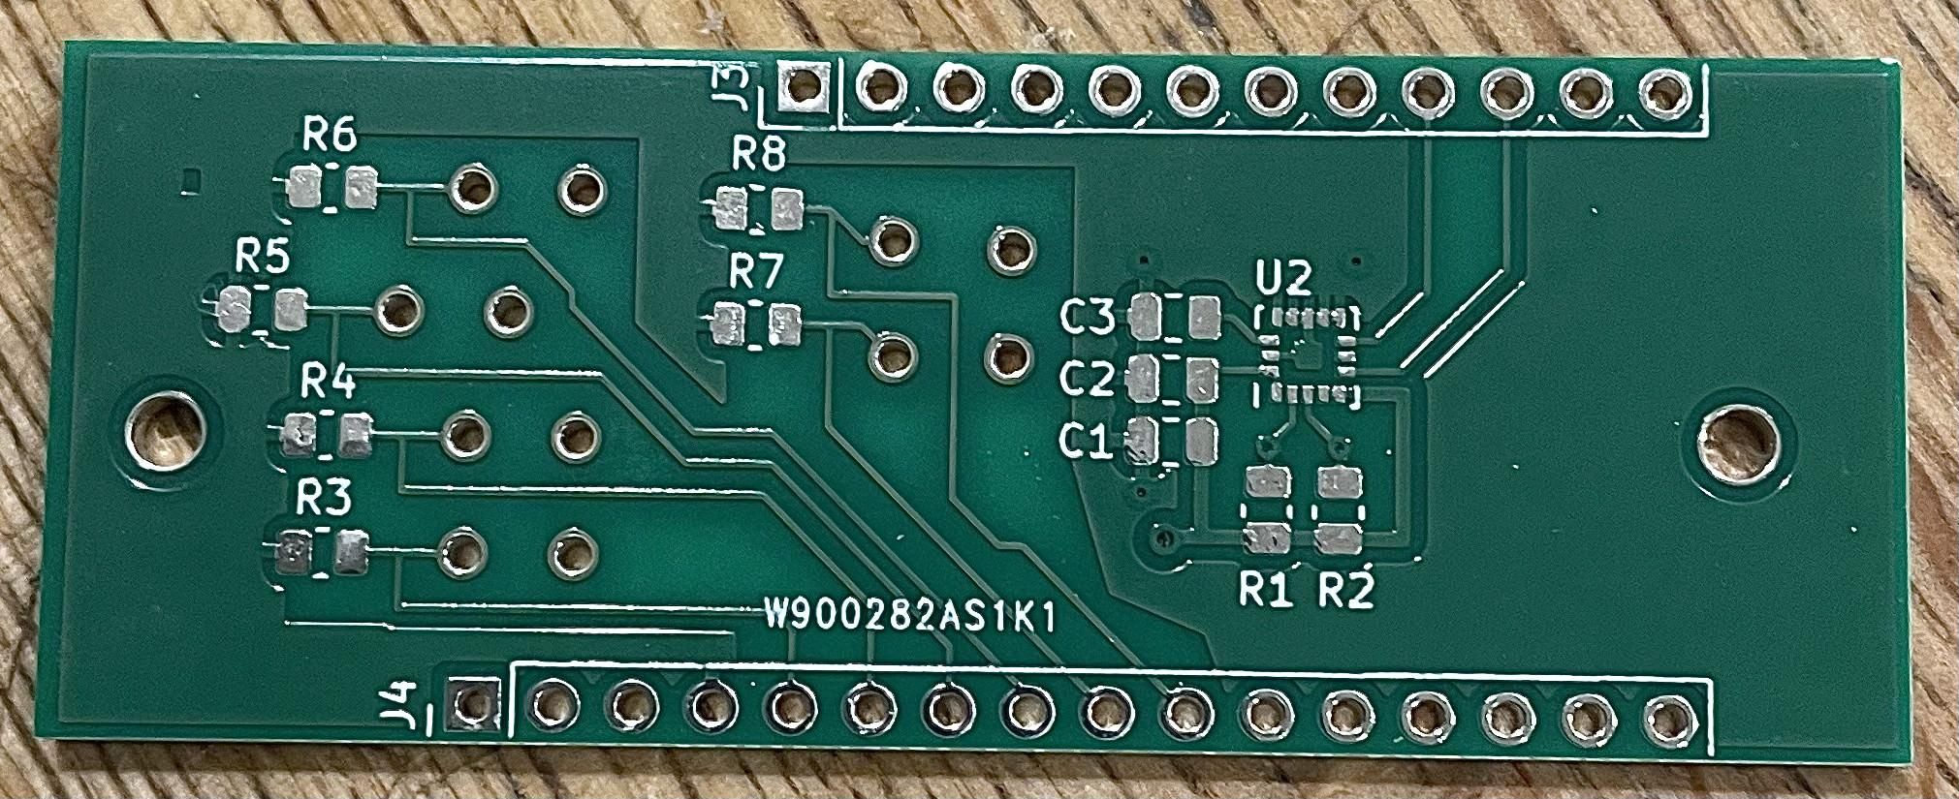
Distinctions
Trained models to identify activities
Activity data includes running, standing, jumping, walking, sitting, going upstairs, and downstairs.
Android Mobile App with Aesthetic UI Design
Custom PCB
Machine Learning Feature

Slide 5
Project Overview
What is the Smart Sole Shoe?
What are the critical features?
Project
Distinctions
This is a wearable insole system that uses pressure sensors to monitor how you stand, how much weight you put on your feet, and how you walk. It sends all this information wirelessly to a mobile app.
Real-time foot pressure distribution mapping and activity prediction
Android Mobile App Connected via Bluetooth
Comfortable to wear and durable enough to run and jump on
Full day battery life rechargeable through micro-USB
Visually appealing UI Android App
Custom PCB Board (Schematic & Layout)
Machine Learning deployment on app for Activity Prediction

Slide 6
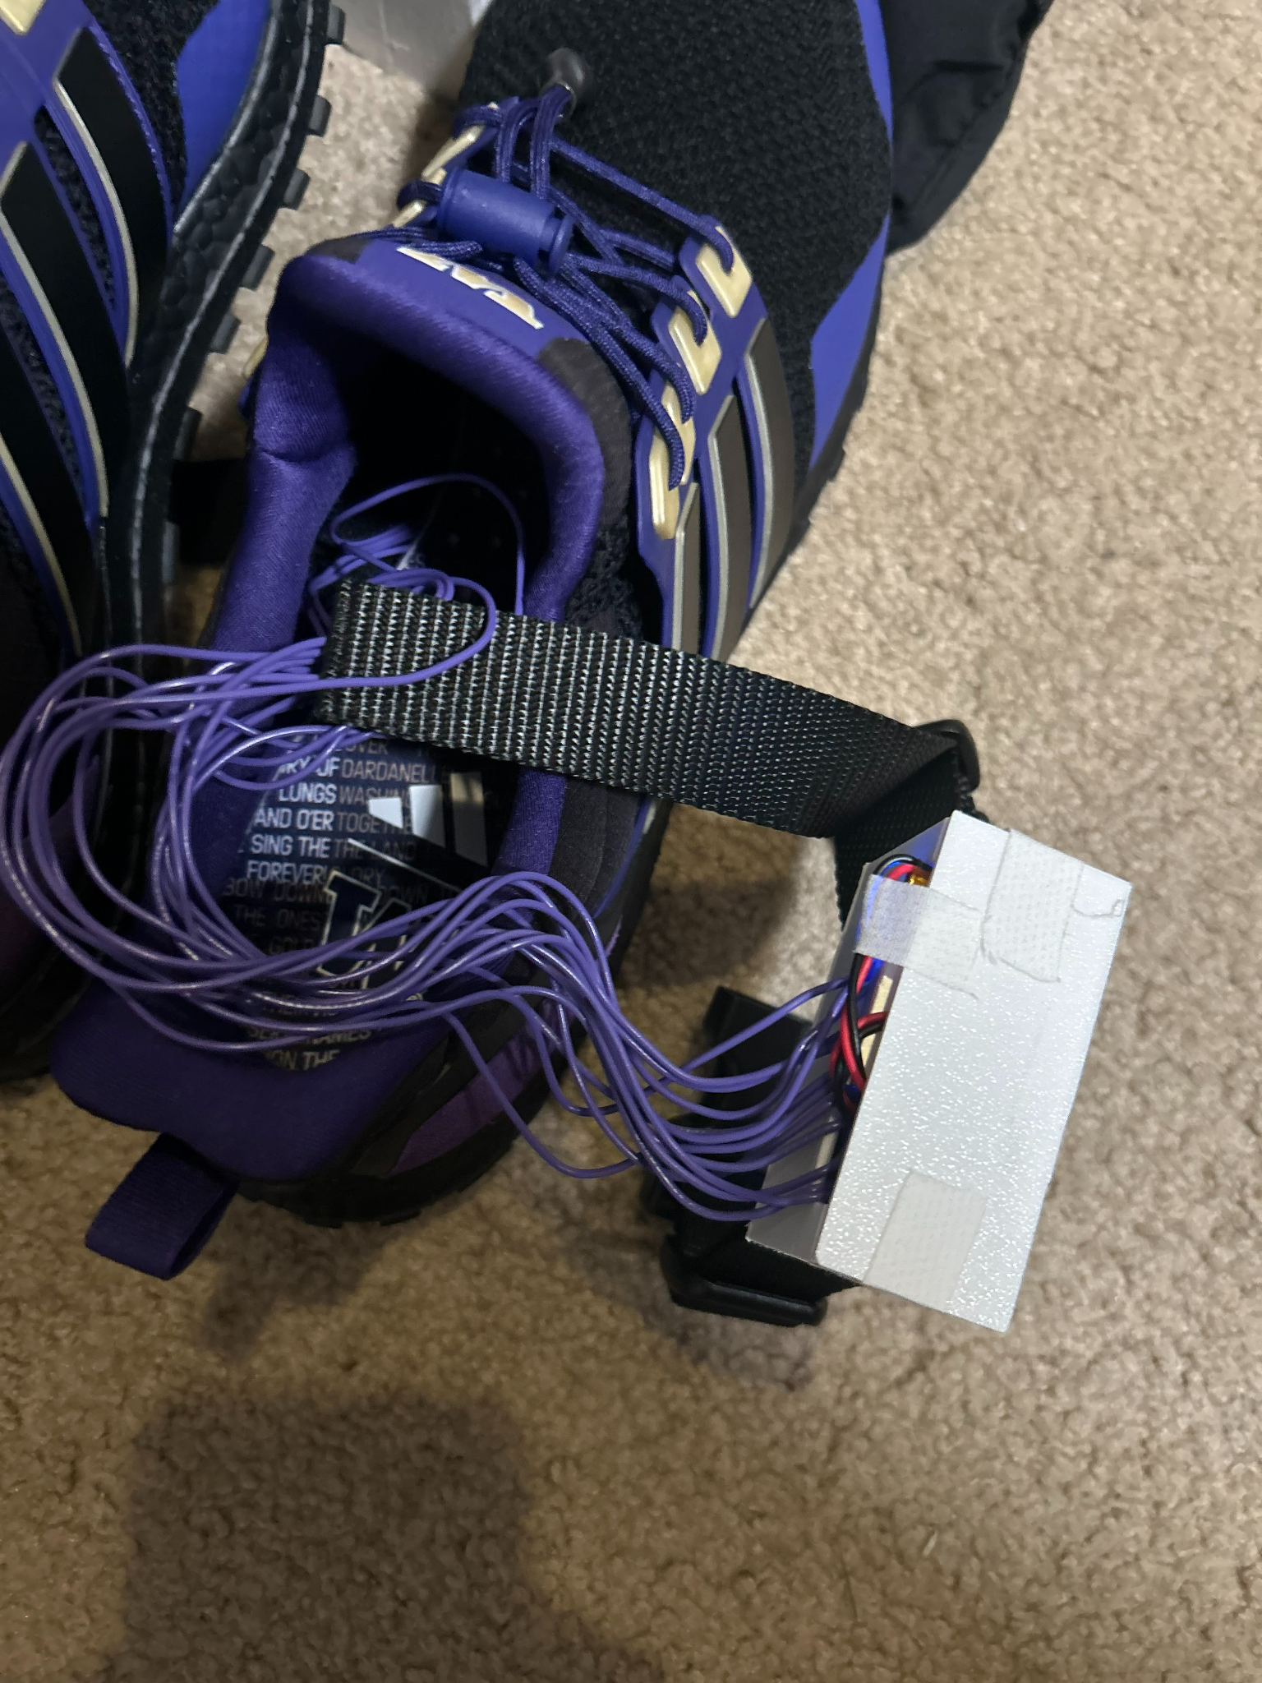
02
LIVE DEMO
of the
application.

Slide 7
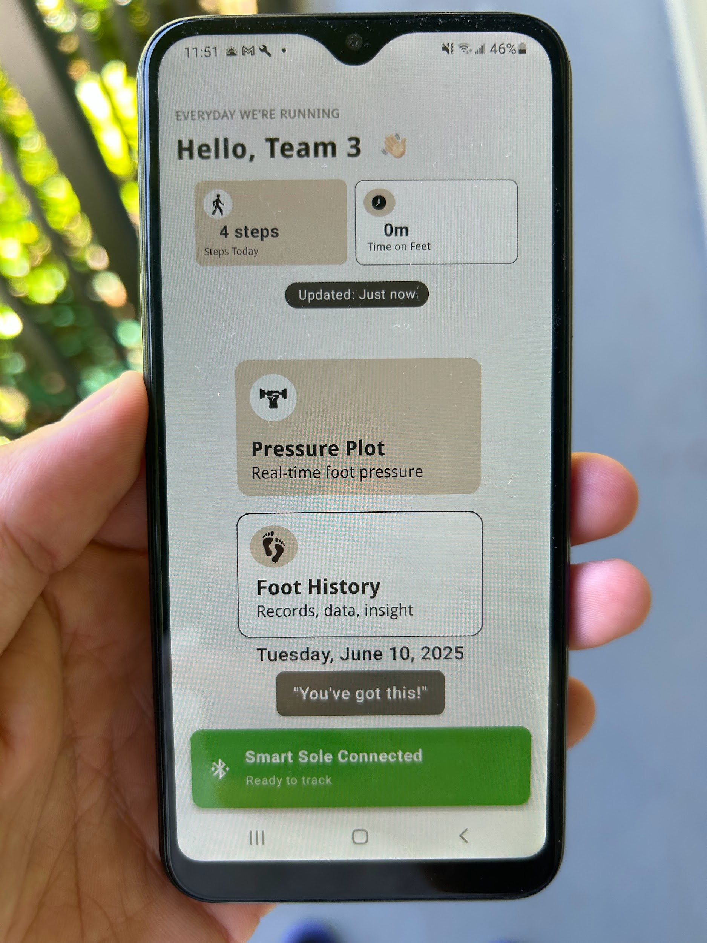
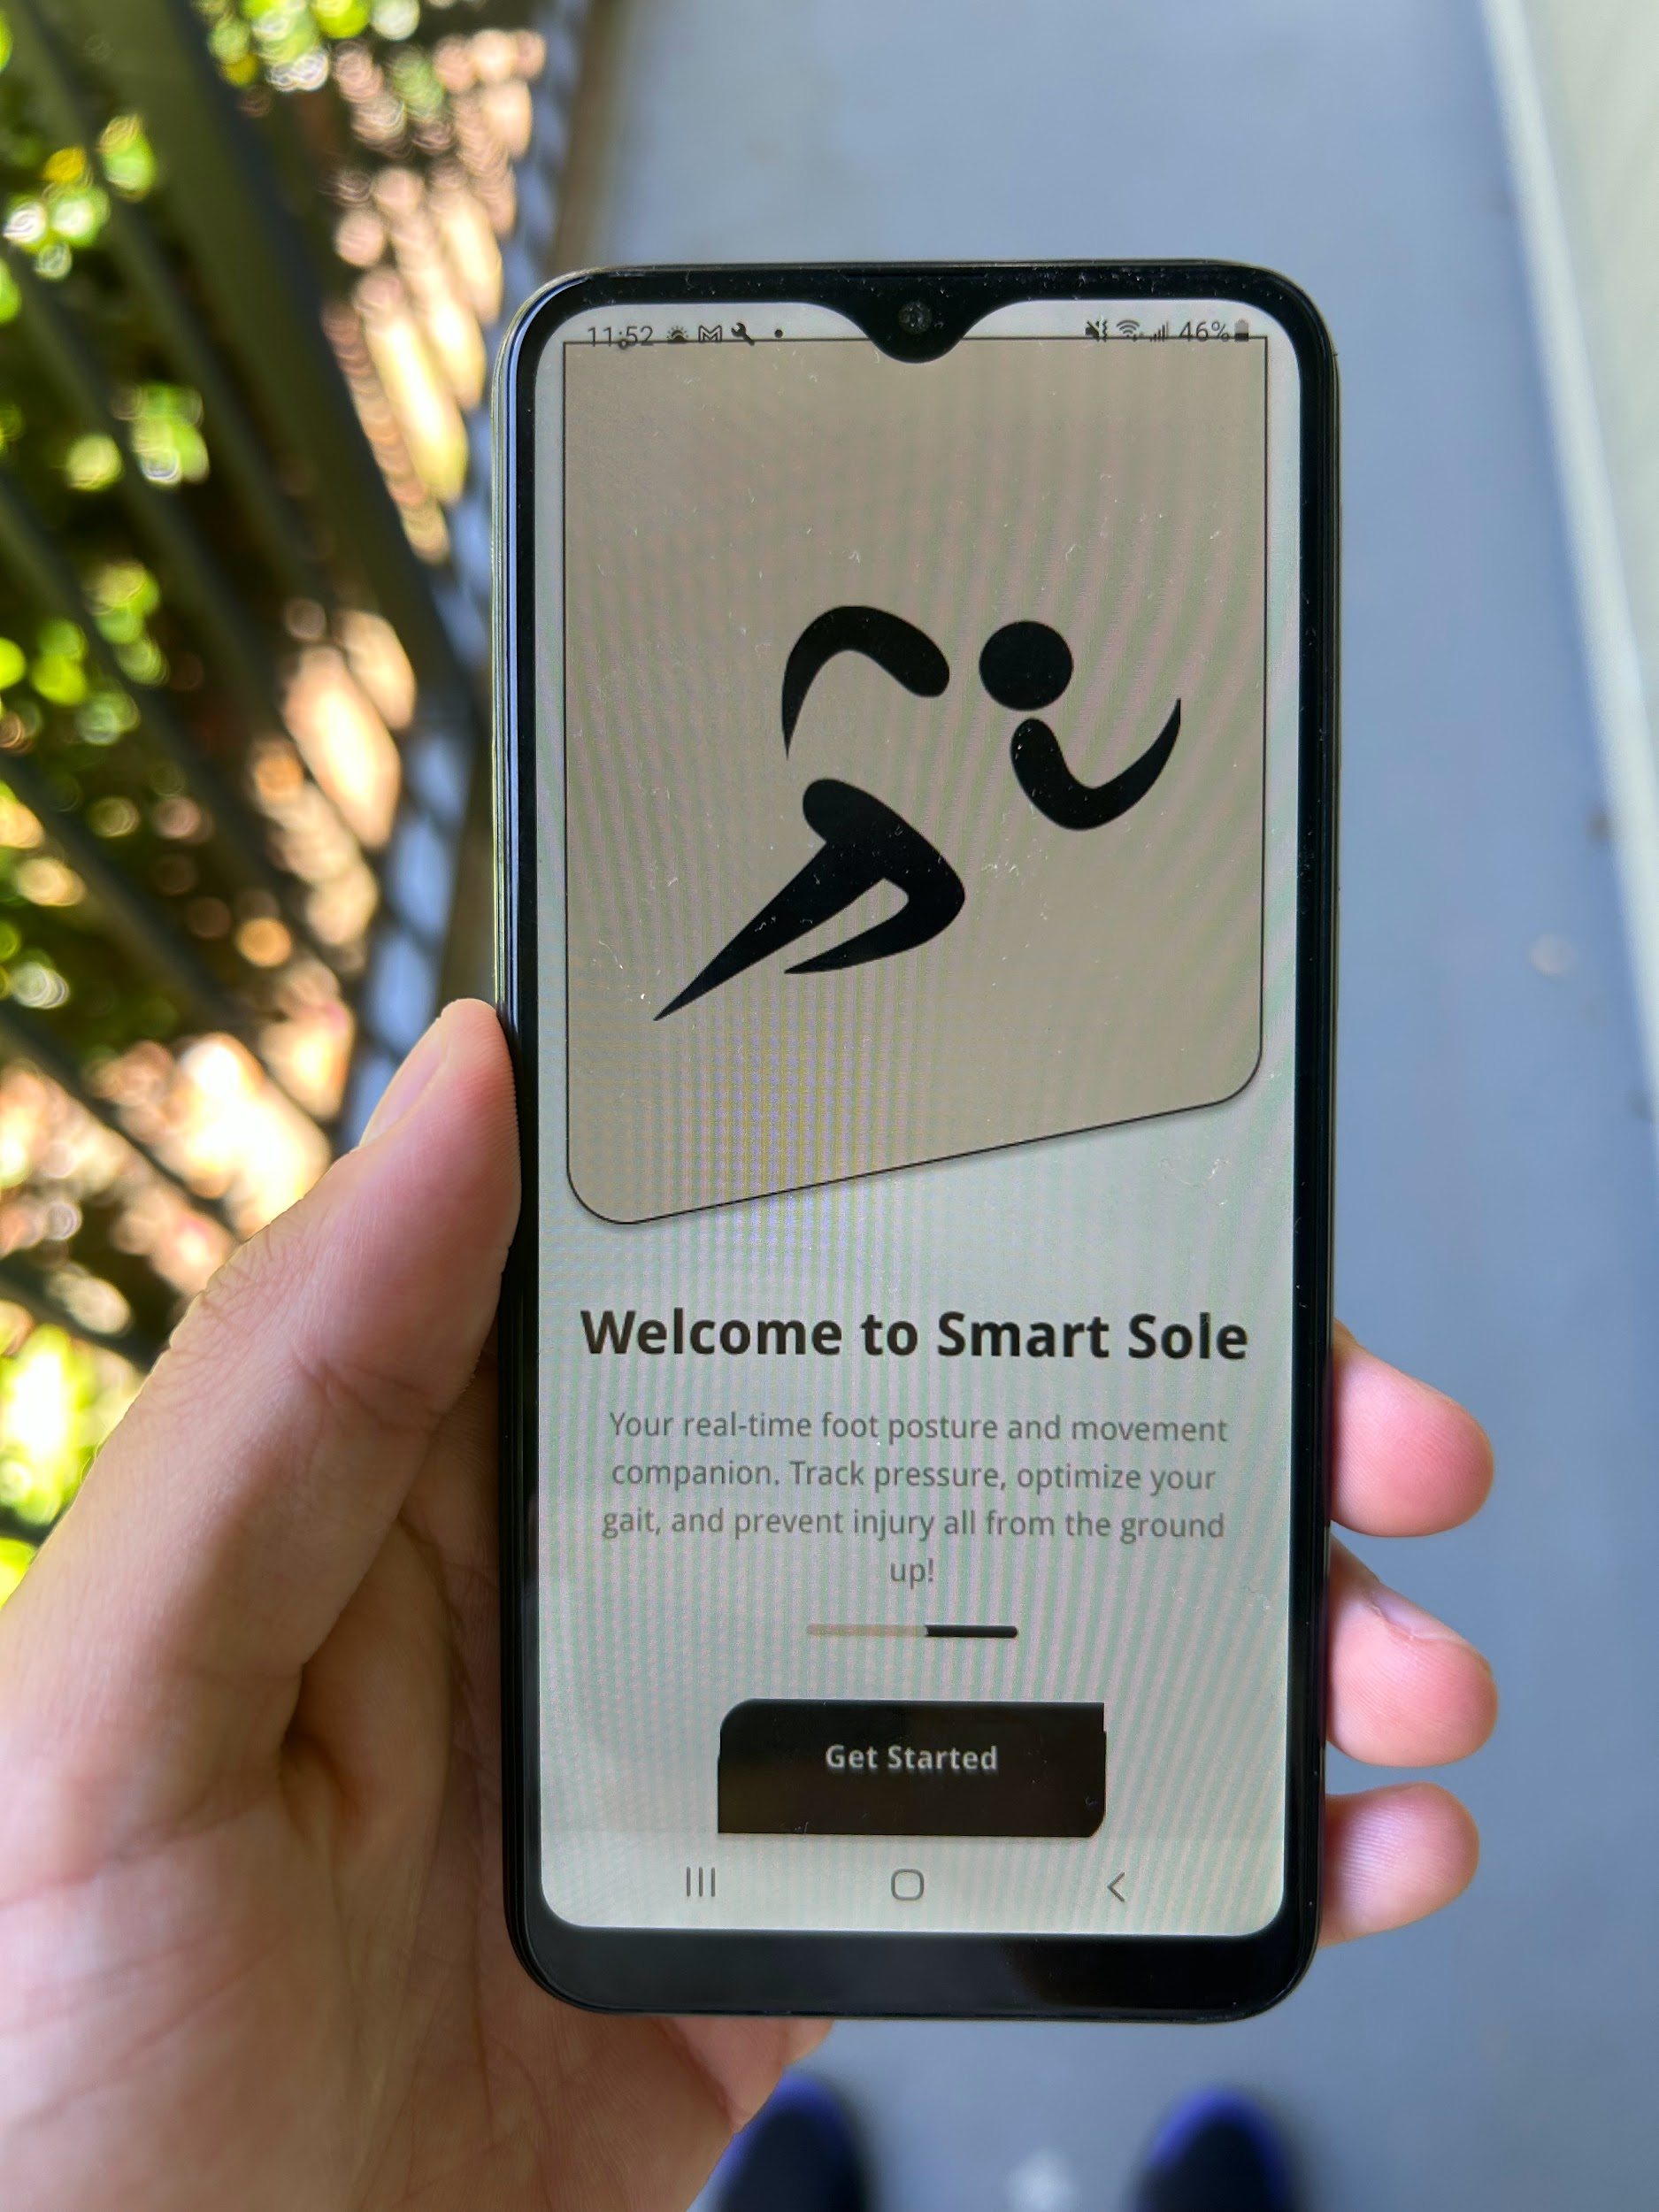

Slide 8
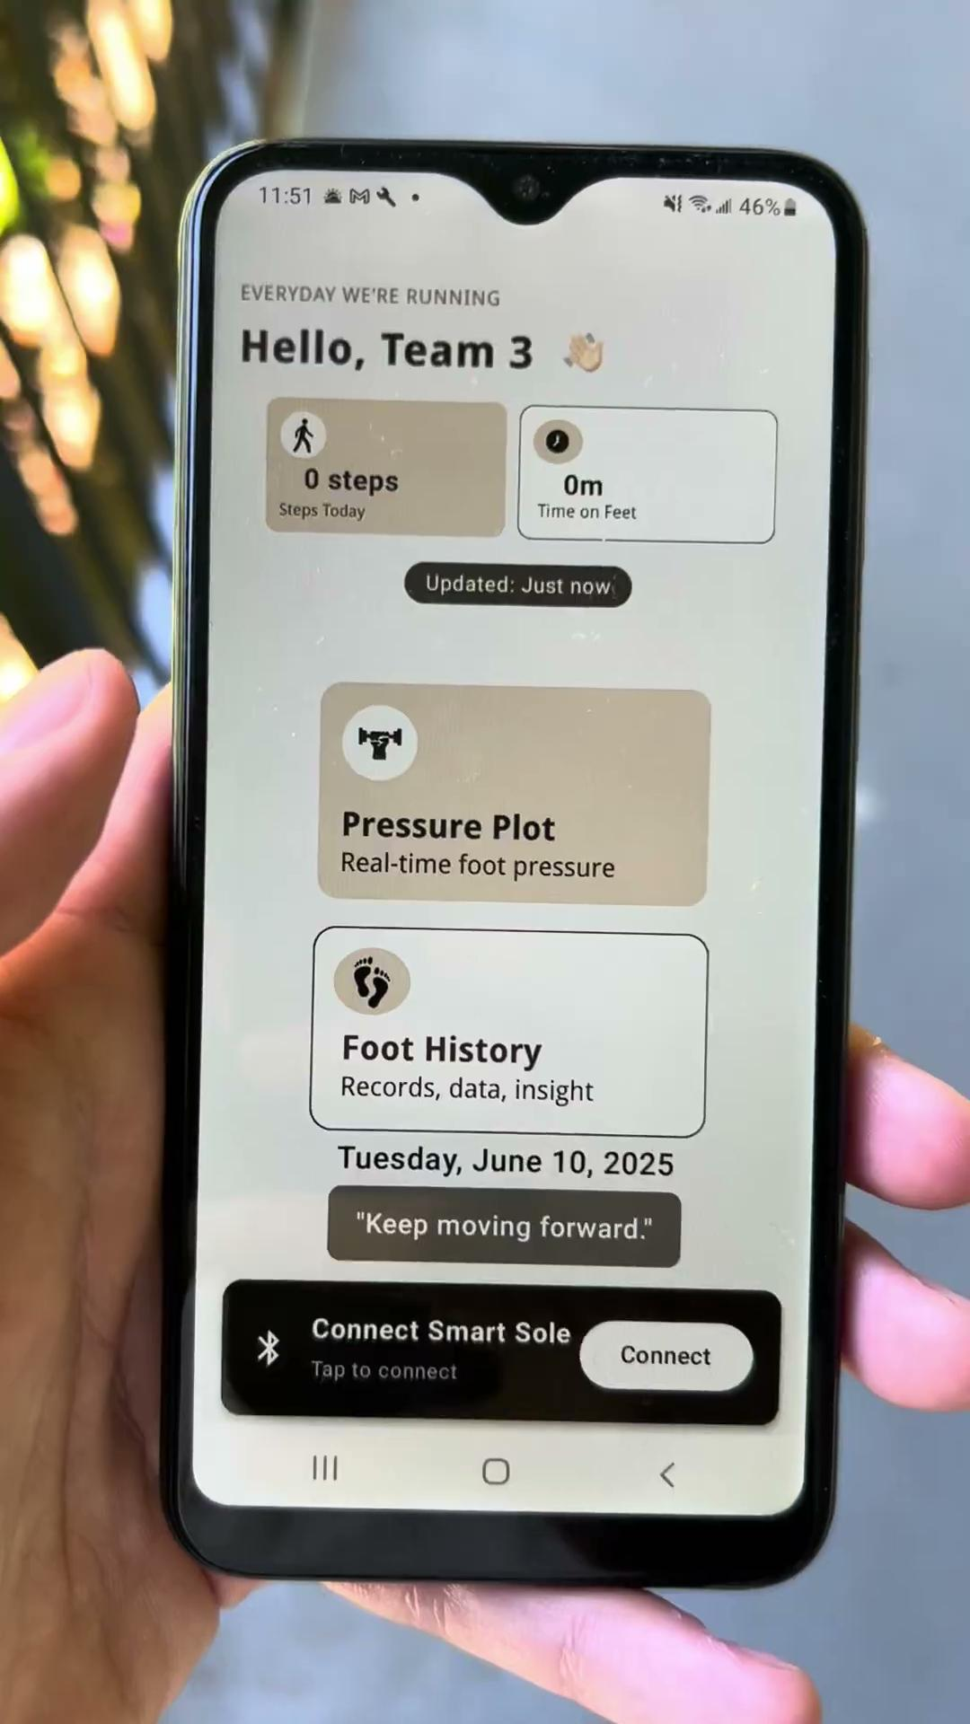
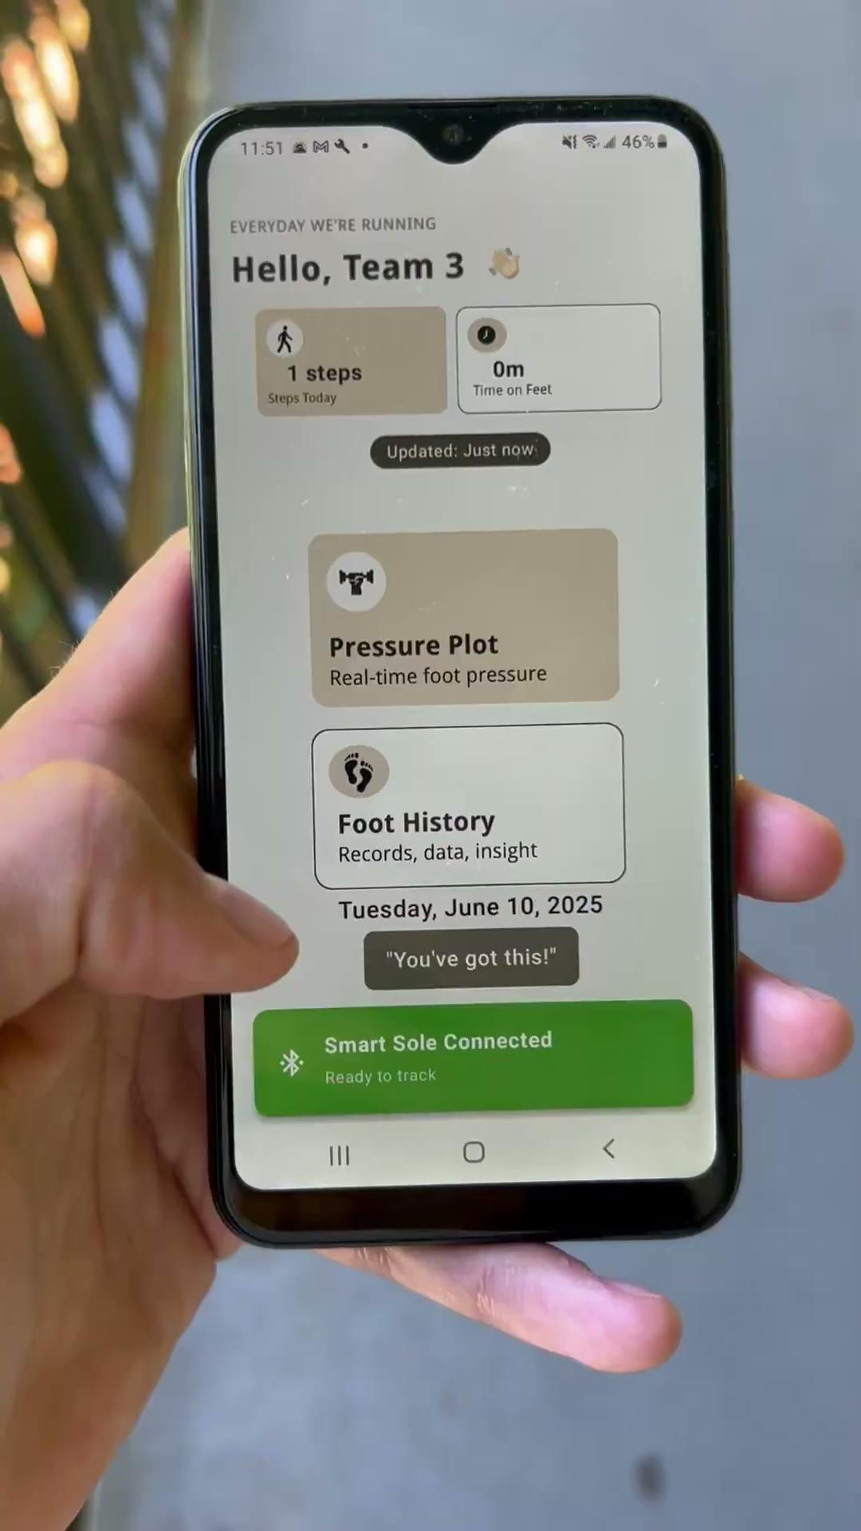

Slide 9
03
LIVE DEMO of the Activity Prediction using Machine Learning

Slide 10
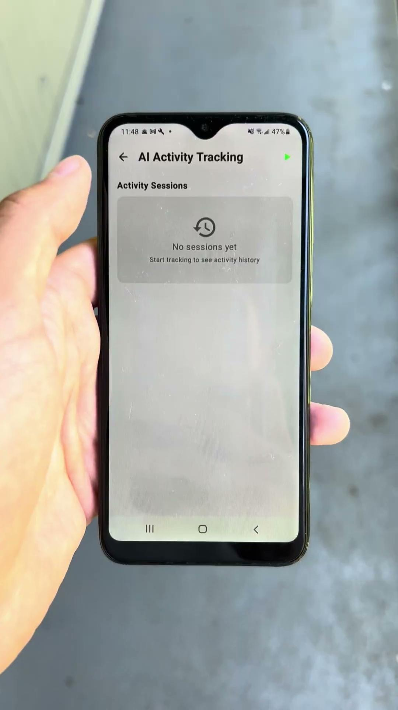

Slide 11
04 & 05
Challenges Faced & Biggest Takeaways

Slide 12
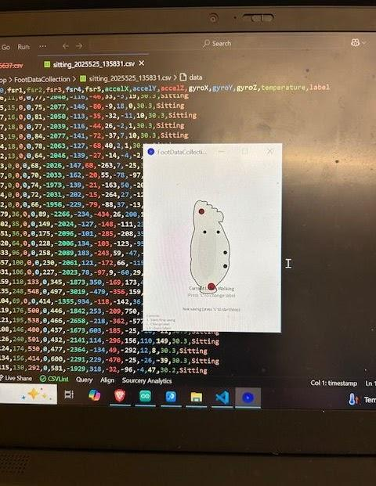
Challenges Faced
Software & Hardware Integration - Connecting Android App to Microcontroller Bluetooth and getting data sent fast enough
Software - Frontend Development and Training Data to Achieve Accurate Activity Prediction. Need way more data.
Hardware - Creating a Custom PCB Layout and ordering stencil for PCB solder paste

Slide 13
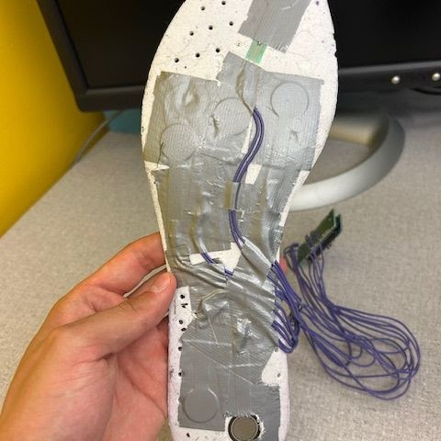
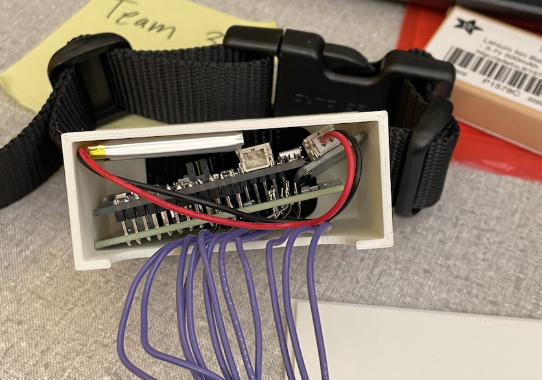
Biggest Takeaways
Developing product end-to-end from design to final physical prototype
Importance of Iterative Feedback & Testing
Cross-Functional Team Collaboration
Time management with a short timeline

Slide 14
03
Details on the hardware prototype.

Slide 15
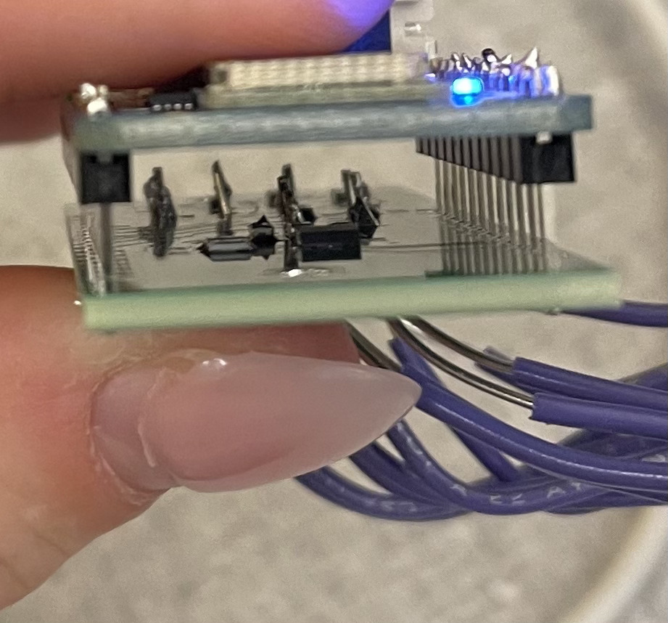
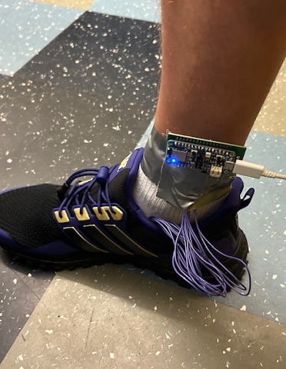
Hardware
Prototype with assembled PCB tested successfully — it survived running and jumping and feels comfortable under the foot.
Currently designing and 3D printing an enclosure for the final product.
3D printed box based on hardware component measurements

Slide 16
04
Details on the software prototype.

Slide 17
Android Mobile App Display

Slide 18
Connecting App with Hardware via Bluetooth
Used the BLE Library to connect the App with the microcontroller for data transmission through
Permissions Setup
Device Scanning
GATT Service Discovery (gattCallback)
Characteristic Notification Setup
Receiving & Parsing Sensor Data Packets

Slide 19
Machine Learning Feature
Trained models to identify activities and estimate walking health based on these patterns.
Activity data includes running, jumping, walking, sitting, going upstairs, and downstairs.
Walking health data covers normal walking, heel strike, toe walking, pronation, and supination.

Slide 20



Alternative resources
https://sites.google.com/uw.edu/smartsole/

